Slide 1
Campus Recruitment System
Keerthiga Surendar
10/24/2021
Notes:
This template can be used as a starter file to give updates for project milestones.
Sections
Right-click on a slide to add sections. Sections can help to organize your slides or facilitate collaboration between multiple authors.
Notes
Use the Notes section for delivery notes or to provide additional details for the audience. View these notes in Presentation View during your presentation.
Keep in mind the font size (important for accessibility, visibility, videotaping, and online production)
Coordinated colors
Pay particular attention to the graphs, charts, and text boxes.
Consider that attendees will print in black and white or grayscale. Run a test print to make sure your colors work when printed in pure black and white and grayscale.
Graphics, tables, and graphs
Keep it simple: If possible, use consistent, non-distracting styles and colors.
Label all graphs and tables.

Slide 2
Objective
The campus information system, aims to help students as well as faculty in the best possible way.
To identify the talented and qualified professionals.
This process reduces the time for an industry to pick candidates according to their need.
The placement process done both on on-campus and also of-campus .

Slide 3
Software required:
Front End Tools:
Visual Studio code:
HTML
CSS
Java Script
Back End Tools:
MySql
Jdk 1.8

Slide 4

Project Overview
Online campus information system enables the students to get a better layout of education planning.
Information gathered employing structured interviews from a recognized University.
On- campus process was arranged by their placement officer.
Off-campus process was managed with the co-Ordinator help.

Slide 5
Web pages
Home page
Campus Recruitment System
Placement Officer
Student
Admin

Slide 6
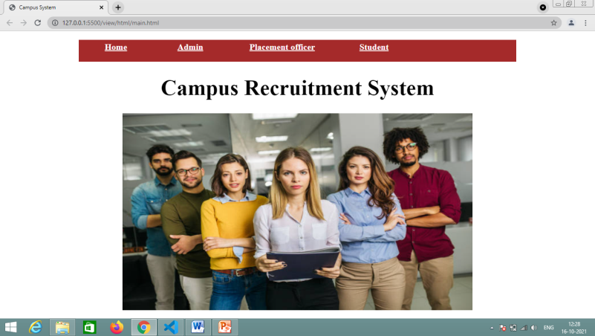
Front Page view
next

Slide 7
Home Tab
Its an promotion page of My application.
The company facility for students and also experienced people can get the complete information of the webpage.
Ever user have own user-id and password to login.

Slide 8
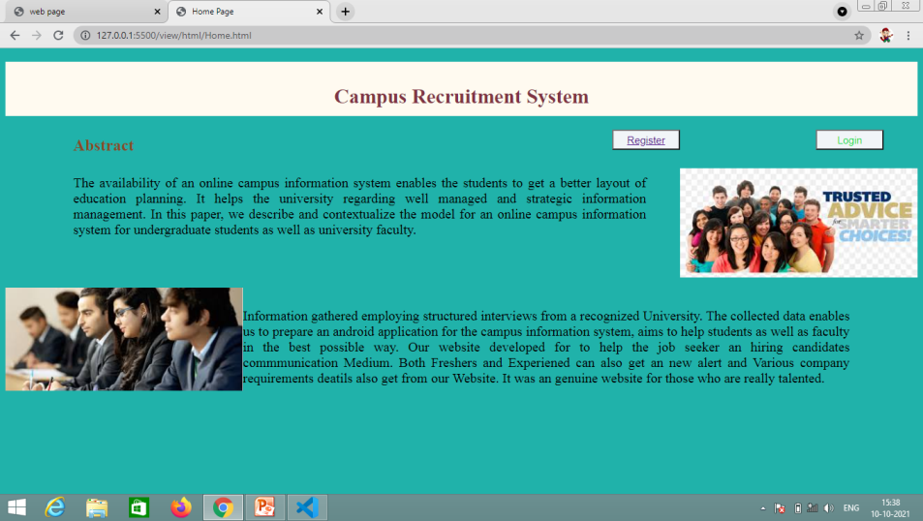
Home Page
Notes:
The following slides show several examples of timelines using SmartArt graphics.
Include a timeline for the project, clearly marking milestones, important dates, and highlight where the project is now.

Slide 9
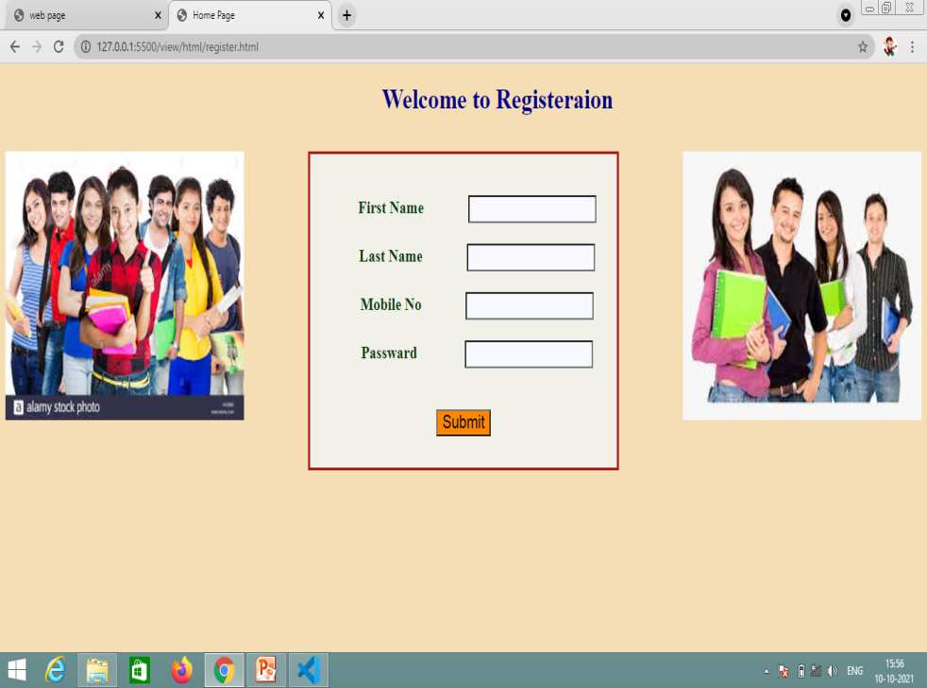
Register page

Slide 10
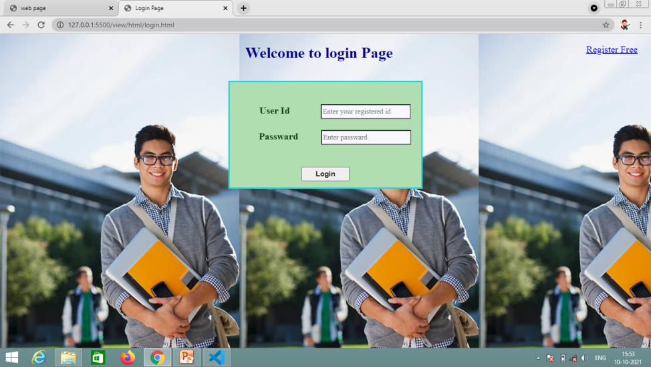
Login Page

Slide 11
Student
Only registered students get the accessing the complete placement details.
Also the existing batch students also welcome to the website ,because they have to know the current requirements of the company.
The student details are individually monitored and provide the better placement details.

Slide 12
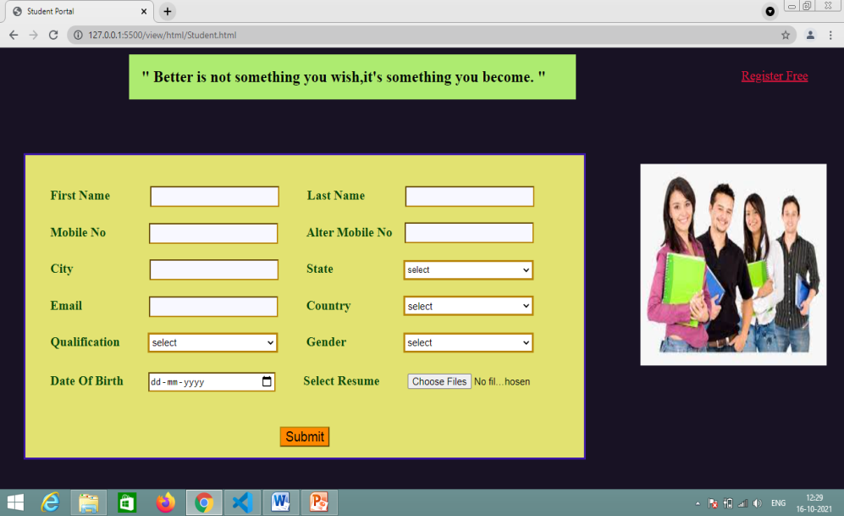
Student portal
next

Slide 13
Admin Tab
Admin only having permission to add the co-ordinator of this site.
Admin only can change the entire settings .
The placement co-ordinator pages directly monitored .

Slide 14
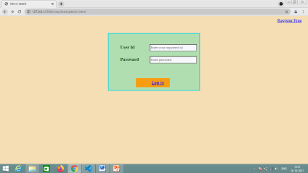
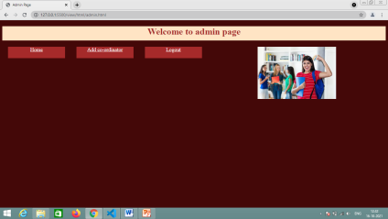
Admin Pages
next
Login page
Admin Main Page

Slide 15
Placement officer
Placement officer have an important role.
He wants to maintain the student details and also the hiring company details.
He is also an part of co-ordinator .
Officer can arrange the training and made an awareness to the users.

Slide 16
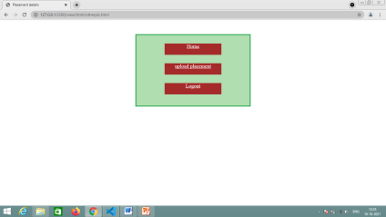
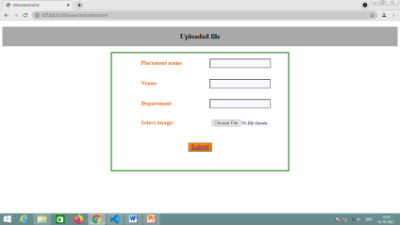
Placement officer
next
Placement Officer
Upload other placement

Slide 17
Thank You

